Slide 1
Reinforcement Learning August 2, 2019
MMCi Applied Data Science
Block 5, Lecture 1
Matthew Engelhard

Slide 2
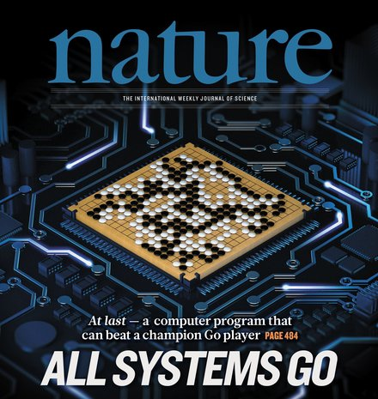


Slide 3
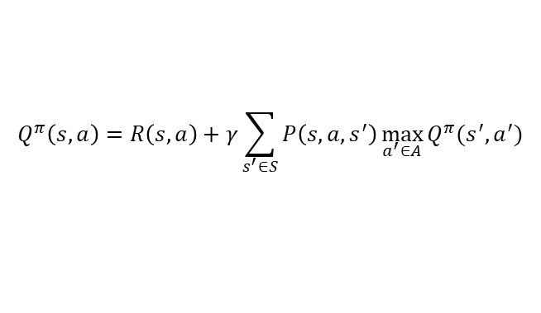
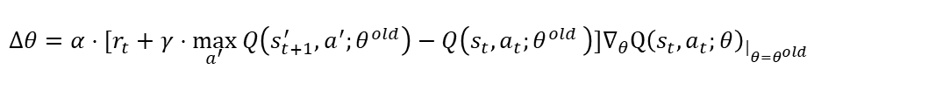
$$Q^{π}\left(s,a\right)=R\left(s,a\right)+γ\sum_{s^{′}∈S}{P\left(s,a,s^{′}\right)\max_{a^{′}∈A}{Q^{π}(s^{′},a^{′})}}$$
${Q(s_{t},a_{t};θ}^{new})=Q(s_{t},a_{t};θ^{old}+α⋅[r_{t}+γ⋅\max_{a^{′}} Q\left(s_{t+1}^{′},a^{′};θ^{old}\right)−Q\left(s_{t},a_{t}{;θ}^{old}\right)]∇_{θ}Q{\left(s_{t},a_{t};θ\right)}_{{\left.​\right|}_{θ=θ^{old}}}$)
$Δθ=α⋅[r_{t}+γ⋅\max_{a^{′}} Q\left(s_{t+1}^{′},a^{′};θ^{old}\right)−Q\left(s_{t},a_{t}{;θ}^{old}\right)]∇_{θ}Q{\left(s_{t},a_{t};θ\right)}_{{\left.​\right|}_{θ=θ^{old}}}$
$${Q(s_{t},a_{t};θ}^{old}+Δθ)≈Q\left(s_{t},a_{t};θ^{old}\right)+α⋅\left[r_{t}+γ⋅\max_{a^{′}} Q\left(s_{t+1}^{′},a^{′};θ^{old}\right)−Q\left(s_{t},a_{t}{;θ}^{old}\right)\right]||∇_{θ}Q{\left(s_{t},a_{t};θ\right)}_{{\left.​\right|}_{θ=θ^{old}}}||_{2}^{2}$$

Slide 4
$$Q^{π}\left(s,a\right)=R\left(s,a\right)+γ\sum_{s^{′}∈S}{P\left(s,a,s^{′}\right)\max_{a^{′}∈A}{Q^{π}(s^{′},a^{′})}}$$
MATHEMATICS!!
${Q(s_{t},a_{t};θ}^{new})=Q(s_{t},a_{t};θ^{old}+α⋅[r_{t}+γ⋅\max_{a^{′}} Q\left(s_{t+1}^{′},a^{′};θ^{old}\right)−Q\left(s_{t},a_{t}{;θ}^{old}\right)]∇_{θ}Q{\left(s_{t},a_{t};θ\right)}_{{\left.​\right|}_{θ=θ^{old}}}$)
$Δθ=α⋅[r_{t}+γ⋅\max_{a^{′}} Q\left(s_{t+1}^{′},a^{′};θ^{old}\right)−Q\left(s_{t},a_{t}{;θ}^{old}\right)]∇_{θ}Q{\left(s_{t},a_{t};θ\right)}_{{\left.​\right|}_{θ=θ^{old}}}$
$${Q(s_{t},a_{t};θ}^{old}+Δθ)≈Q\left(s_{t},a_{t};θ^{old}\right)+α⋅\left[r_{t}+γ⋅\max_{a^{′}} Q\left(s_{t+1}^{′},a^{′};θ^{old}\right)−Q\left(s_{t},a_{t}{;θ}^{old}\right)\right]||∇_{θ}Q{\left(s_{t},a_{t};θ\right)}_{{\left.​\right|}_{θ=θ^{old}}}||_{2}^{2}$$

Slide 5
Sequential Decision-Making
An agent
takes actions
based on the state of a system
to maximize reward
Notes:
“Decision-making under uncertainty”

Slide 6
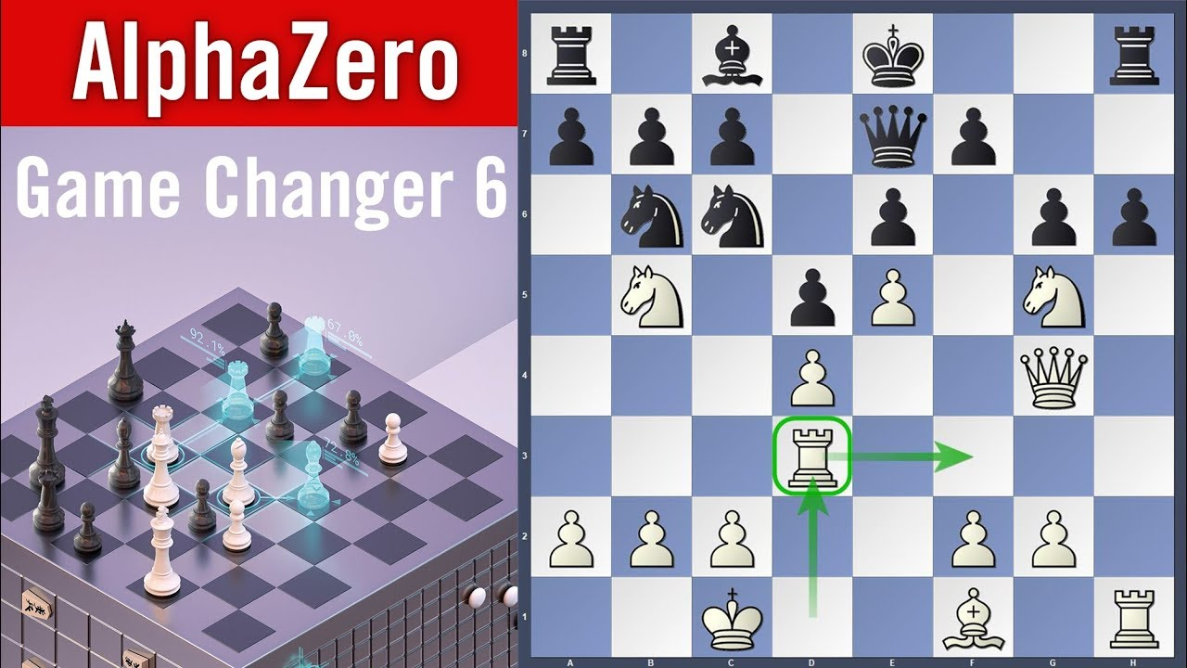
Sequential Decision-Making
An agent
takes actions
based on the state of a system
to maximize reward
Notes:
examples: robot navigating
Computer program playing video game
Doctor deciding on treatment(s)
Two things to note:
- this is happening on an ongoing basis
- Reward must be quantified numerically

Slide 7
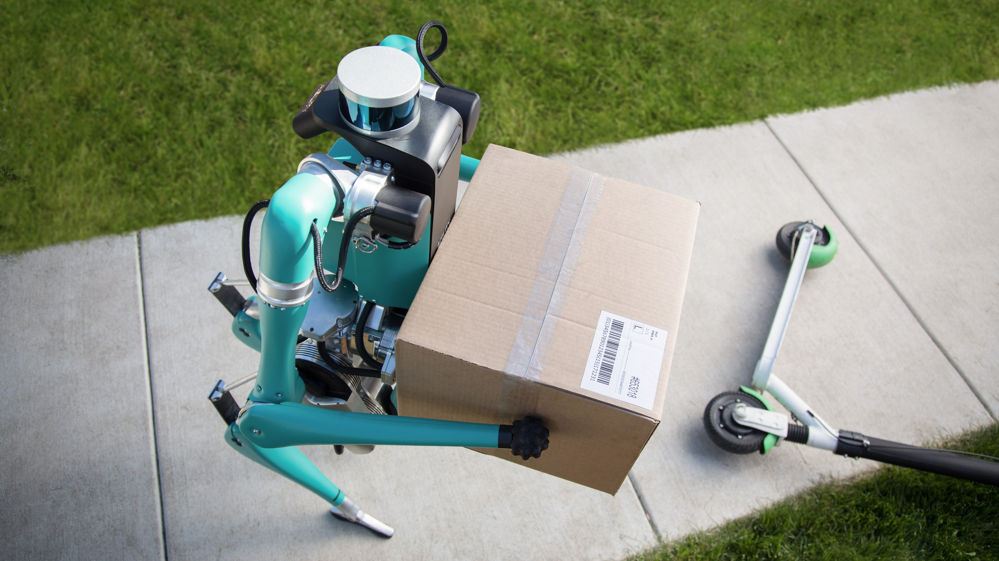
Sequential Decision-Making
An agent
takes actions
based on the state of a system
to maximize reward
https://www.techradar.com/news/fords-robot-postman-will-deliver-packages-to-your-front-door
Notes:
examples: robot navigating
Computer program playing video game
Doctor deciding on treatment(s)
Two things to note:
- this is happening on an ongoing basis
- Reward must be quantified numerically

Slide 8
Sequential Medical Decision-Making
Consider a clinician seeking to treat patients effectively while minimizing costs
The health of each patient is observed as a set of clinical variables
Assume the clinician has a fixed set of actions he or she can perform
Each action may (or may not) change the health state of the patient.
The clinician seeks a policy that achieves the best outcomes at the lowest average cost
Could apply to particular types of patients (e.g., diabetics) or in particular settings within a health system (e.g., ICU)
An agent
takes actions
based on the state of a system
to maximize reward
Notes:
“Decision-making under uncertainty”

Slide 9
Sequential Medical Decision-Making
Consider a clinician seeking to treat patients effectively while minimizing costs
The health of each patient is observed as a set of clinical variables
Assume the clinician has a fixed set of actions he or she can perform
Each action may (or may not) change the health state of the patient.
The clinician seeks a policy that achieves the best outcomes at the lowest average cost
Could apply to particular types of patients (e.g., diabetics) or in particular settings within a health system (e.g., ICU)
An agent
takes actions
based on the state of a system
to maximize reward
Notes:
“Decision-making under uncertainty”

Slide 10
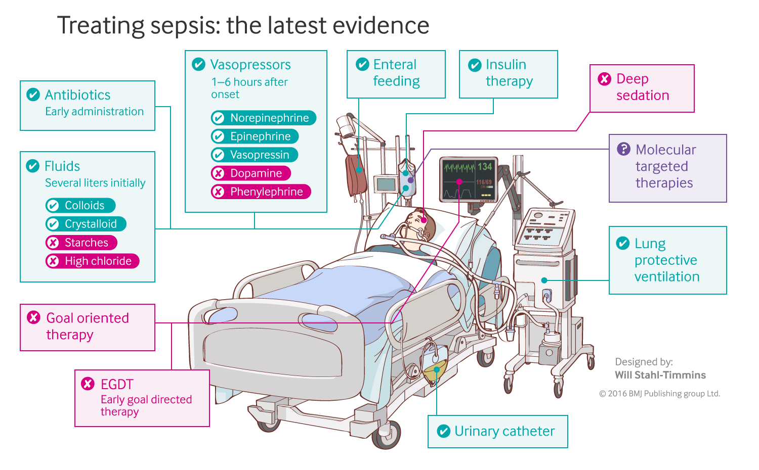
Sequential Medical Decision-Making
An agent
takes actions
based on the state of a system
to maximize reward
Notes:
examples: robot navigating
Computer program playing video game
Doctor deciding on treatment(s)
Two things to note:
- this is happening on an ongoing basis
- Reward must be quantified numerically

Slide 11
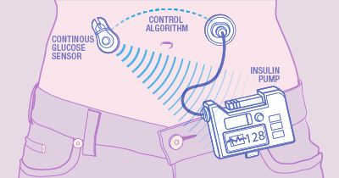
Sequential Medical Decision-Making
An agent
takes actions
based on the state of a system
to maximize reward
Notes:
examples: robot navigating
Computer program playing video game
Doctor deciding on treatment(s)
Two things to note:
- this is happening on an ongoing basis
- Reward must be quantified numerically

Slide 12
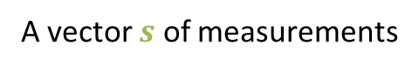
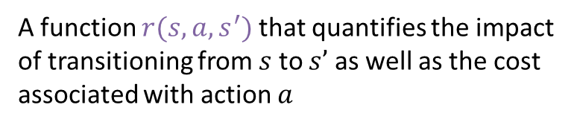
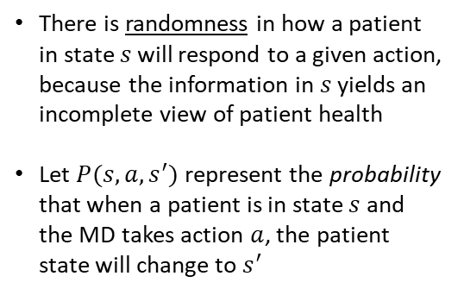

There is randomness in how a patient in state 𝑠 will respond to a given action, because the information in 𝑠 yields an incomplete view of patient health
Let $P(s,a,s^{′})$ represent the probability that when a patient is in state $s$ and the MD takes action $a$, the patient state will change to $s^{′}$
Sequential Medical Decision-Making
An agent
takes actions
based on the state of a system
to maximize reward
A set $\{a^{1},…,a^{m}\}$ of possible actions
A vector $s$ of measurements
A function $r(s, a, s^{′})$ that quantifies the impact of transitioning from $s$ to $s’$ as well as the cost associated with action $a$
Notes:
These actions may effect the state, but there is randomness in this, perhaps due to incomplete information

Slide 13

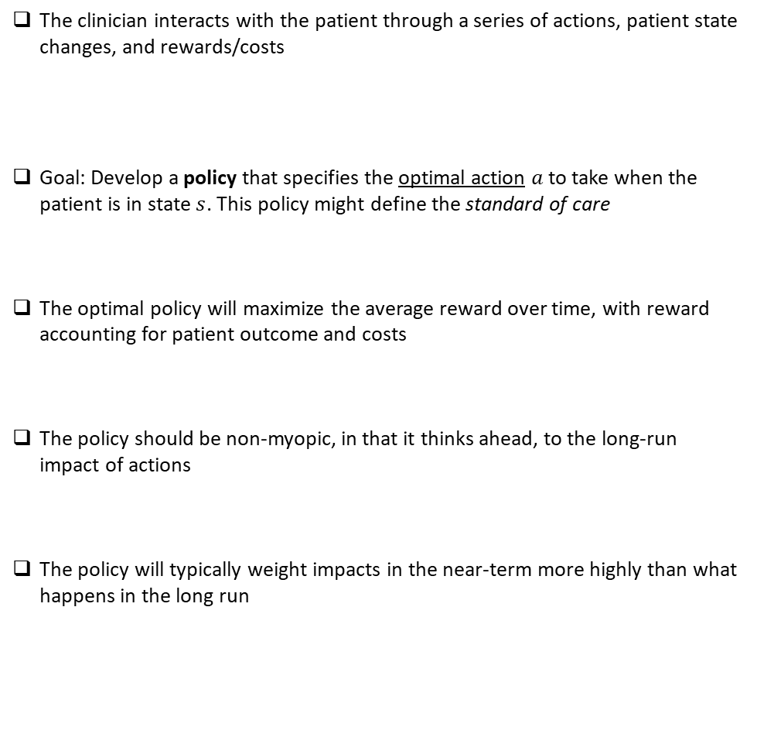
The clinician interacts with the patient through a series of actions, patient state changes, and rewards/costs
Goal: Develop a policy that specifies the optimal action $a$ to take when the patient is in state $s$. This policy might define the standard of care
The optimal policy will maximize the average reward over time, with reward accounting for patient outcome and costs
The policy should be non-myopic, in that it thinks ahead, to the long-run impact of actions
The policy will typically weight impacts in the near-term more highly than what happens in the long run
$… s_{t−1} a_{t−1} r_{t−1} { s}_{t} a_{t} r_{t} { s}_{t+1} …$

Slide 14
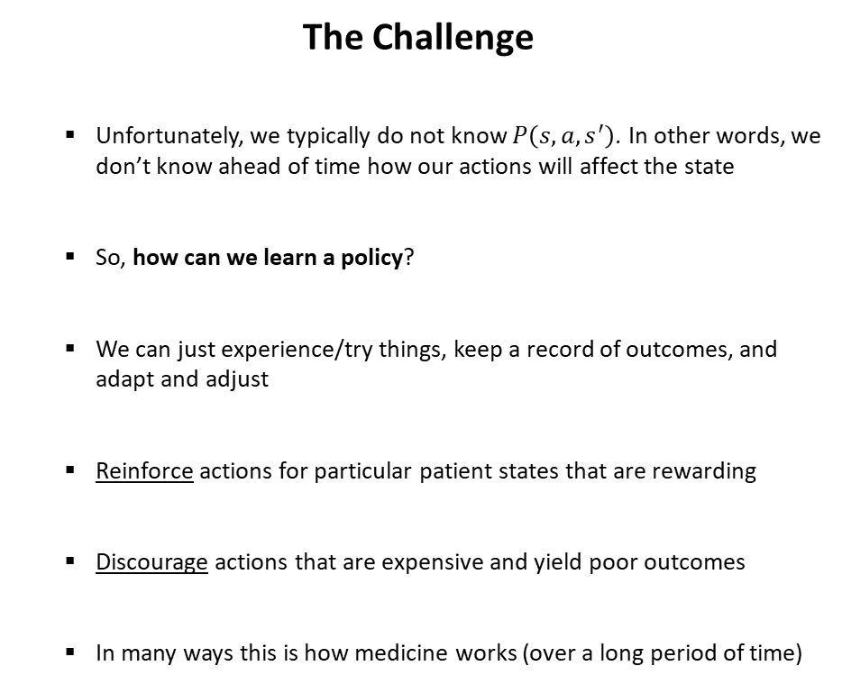
The Challenge
Unfortunately, we typically do not know $P\left(s,a,s^{′}\right)$. In other words, we don’t know ahead of time how our actions will affect the state
So, how can we learn a policy?
We can just experience/try things, keep a record of outcomes, and adapt and adjust
Reinforce actions for particular patient states that are rewarding
Discourage actions that are expensive and yield poor outcomes
In many ways this is how medicine works (over a long period of time)
Notes:
This is where you talk about riding a bike
Two ways to learn: read a manual, study it, know exactly how to respond
Or, just start experimenting.

Slide 15


Reinforcement learning is the formalization of this challenge
Addresses sequential decision making in an uncertain (stochastic) world
Monitoring/Maintenance of Factory
Medicine/Health
Investing

Slide 16
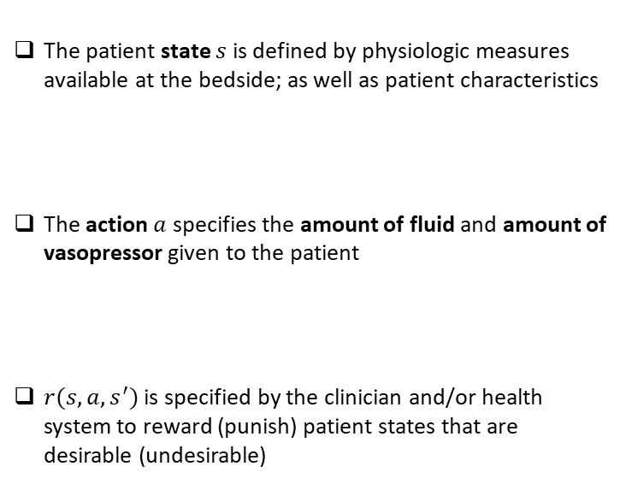

Illustrative Example: Sepsis Management in the ICU
The patient state $s$is defined by physiologic measures available at the bedside; as well as patient characteristics
The action $a$specifies the amount of fluid and amount of vasopressor given to the patient
$r(s,a,s^{′})$ is specified by the clinician and/or health system to reward (punish) patient states that are desirable (undesirable)
Discretize the continuous range of the state values into $n$ distinct bins
Discretize the possible actions into $m$ distinct bins

Slide 17
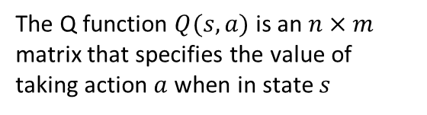
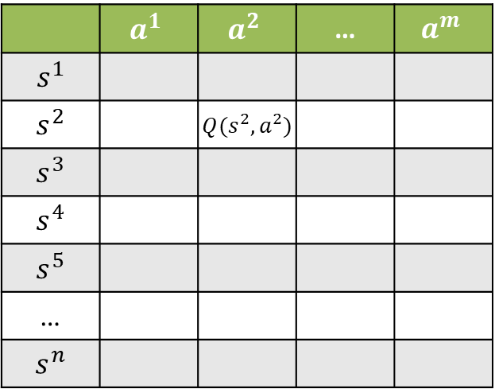
Illustrative Example: Sepsis Management in the ICU
The Q function $Q(s,a)$ is an $n×m$ matrix that specifies the value of taking action $a$ when in state $s$
The patient state $s$is defined by physiologic measures available at the bedside; as well as patient characteristics
The action $a$specifies the amount of fluid and amount of vasopressor given to the patient
$r(s,a,s^{′})$ is specified by the clinician and/or health system to reward (punish) patient states that are desirable (undesirable)
Discretize the continuous range of the state values into $n$ distinct bins
 | $$a^{1}$$ | $$a^{2}$$ | … | $$a^{m}$$
$$s^{1}$$
$$s^{2}$$ |  | $Q(s^{2},a^{2})$
$$s^{3}$$
$$s^{4}$$
$$s^{5}$$
…
$$s^{n}$$
Discretize the possible actions into $m$ distinct bins

Slide 18
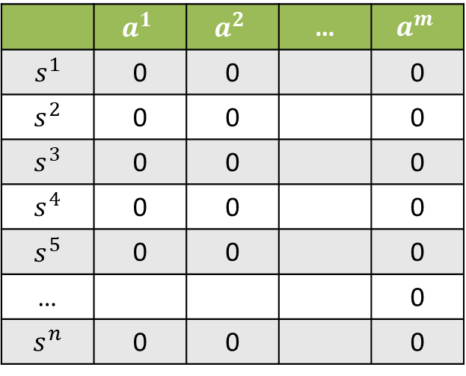
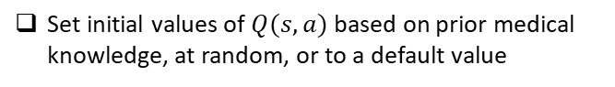
Illustrative Example: Sepsis Management in the ICU
The Q function $Q(s,a)$ is an $n×m$ matrix that specifies the value of taking action $a$ when in state $s$
Set initial values of $Q(s,a)$ based on prior medical knowledge, at random, or to a default value
 | $$a^{1}$$ | $$a^{2}$$ | … | $$a^{m}$$
$$s^{1}$$ | 0 | 0 |  | 0
$$s^{2}$$ | 0 | 0 |  | 0
$$s^{3}$$ | 0 | 0 |  | 0
$$s^{4}$$ | 0 | 0 |  | 0
$$s^{5}$$ | 0 | 0 |  | 0
… |  |  |  | 0
$$s^{n}$$ | 0 | 0 |  | 0

Slide 19
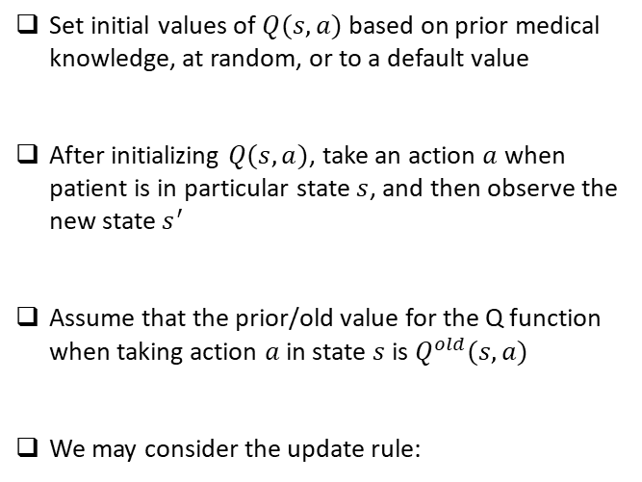
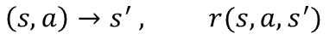
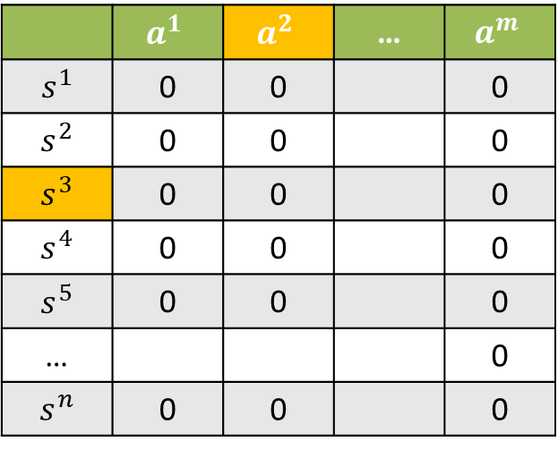
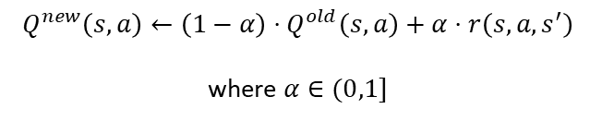
Illustrative Example: Sepsis Management in the ICU
The Q function $Q(s,a)$ is an $n×m$ matrix that specifies the value of taking action $a$ when in state $s$
Set initial values of $Q(s,a)$ based on prior medical knowledge, at random, or to a default value
After initializing $Q(s,a)$, take an action $a$ when patient is in particular state $s$, and then observe the new state $s^{′}$
Assume that the prior/old value for the Q function when taking action $a$ in state $s$ is $Q^{old}(s,a)$
We may consider the update rule:
 | $$a^{1}$$ | $$a^{2}$$ | … | $$a^{m}$$
$$s^{1}$$ | 0 | 0 |  | 0
$$s^{2}$$ | 0 | 0 |  | 0
$$s^{3}$$ | 0 | 0 |  | 0
$$s^{4}$$ | 0 | 0 |  | 0
$$s^{5}$$ | 0 | 0 |  | 0
… |  |  |  | 0
$$s^{n}$$ | 0 | 0 |  | 0
$$\left(s,a\right)→s^{′} , r(s,a,s^{′})$$
$$Q^{new}\left(s,a\right)←\left(1−α\right)⋅Q^{old}\left(s,a\right)+α⋅r\left(s,a,s^{′}\right)$$
where $α∈(0,1]$

Slide 20
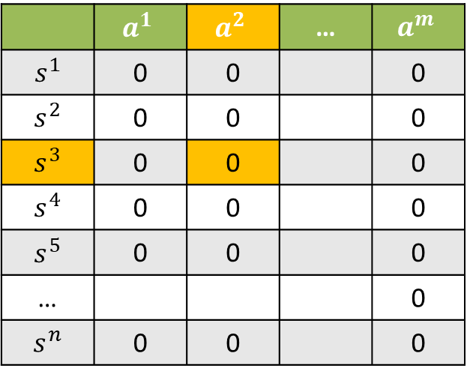
Illustrative Example: Sepsis Management in the ICU
The Q function $Q(s,a)$ is an $n×m$ matrix that specifies the value of taking action $a$ when in state $s$
Set initial values of $Q(s,a)$ based on prior medical knowledge, at random, or to a default value
After initializing $Q(s,a)$, take an action $a$ when patient is in particular state $s$, and then observe the new state $s^{′}$
Assume that the prior/old value for the Q function when taking action $a$ in state $s$ is $Q^{old}(s,a)$
We may consider the update rule:
 | $$a^{1}$$ | $$a^{2}$$ | … | $$a^{m}$$
$$s^{1}$$ | 0 | 0 |  | 0
$$s^{2}$$ | 0 | 0 |  | 0
$$s^{3}$$ | 0 | 0 |  | 0
$$s^{4}$$ | 0 | 0 |  | 0
$$s^{5}$$ | 0 | 0 |  | 0
… |  |  |  | 0
$$s^{n}$$ | 0 | 0 |  | 0
$$\left(s,a\right)→s^{′} , r(s,a,s^{′})$$
$$Q^{new}\left(s,a\right)←\left(1−α\right)⋅Q^{old}\left(s,a\right)+α⋅r\left(s,a,s^{′}\right)$$
where $α∈(0,1]$

Slide 21
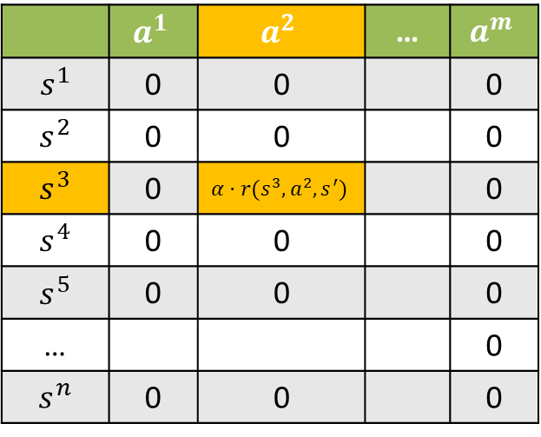
Illustrative Example: Sepsis Management in the ICU
The Q function $Q(s,a)$ is an $n×m$ matrix that specifies the value of taking action $a$ when in state $s$
Set initial values of $Q(s,a)$ based on prior medical knowledge, at random, or to a default value
After initializing $Q(s,a)$, take an action $a$ when patient is in particular state $s$, and then observe the new state $s^{′}$
Assume that the prior/old value for the Q function when taking action $a$ in state $s$ is $Q^{old}(s,a)$
We may consider the update rule:
 | $$a^{1}$$ | $$a^{2}$$ | … | $$a^{m}$$
$$s^{1}$$ | 0 | 0 |  | 0
$$s^{2}$$ | 0 | 0 |  | 0
$$s^{3}$$ | 0 | $$α⋅r(s^{3},a^{2},s^{′})$$ |  | 0
$$s^{4}$$ | 0 | 0 |  | 0
$$s^{5}$$ | 0 | 0 |  | 0
… |  |  |  | 0
$$s^{n}$$ | 0 | 0 |  | 0
$$\left(s,a\right)→s^{′} , r(s,a,s^{′})$$
$$Q^{new}\left(s,a\right)←\left(1−α\right)⋅Q^{old}\left(s,a\right)+α⋅r\left(s,a,s^{′}\right)$$
where $α∈(0,1]$

Slide 22
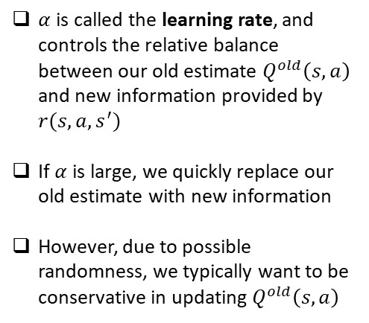
Simple, Intuitive Solution
$Q^{new}\left(s,a\right)←(1−α)⋅Q^{old}\left(s,a\right)+α⋅ r\left(s,a,s^{′}\right),$ with $α∈(0,1]$
$α$ is called the learning rate, and controls the relative balance between our old estimate $Q^{old}\left(s,a\right)$ and new information provided by $r(s,a,s^{′})$
If $α$is large, we quickly replace our old estimate with new information
However, due to possible randomness, we typically want to be conservative in updating $Q^{old}\left(s,a\right)$

Slide 23
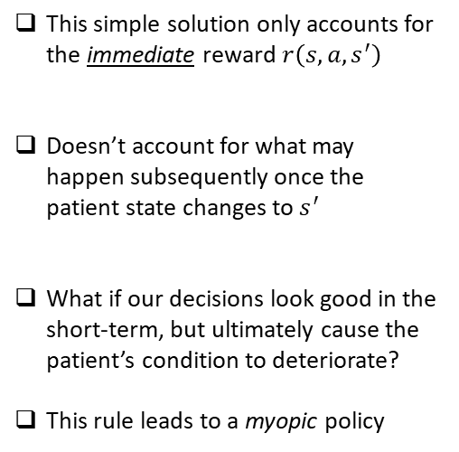
Problem: We’re only looking one step ahead!
$Q^{new}\left(s,a\right)←(1−α)⋅Q^{old}\left(s,a\right)+α⋅ r\left(s,a,s^{′}\right),$ with $α∈(0,1]$
This simple solution only accounts for the immediate reward $r\left(s,a,s^{′}\right)$
Doesn’t account for what may happen subsequently once the patient state changes to $s^{′}$
What if our decisions look good in the short-term, but ultimately cause the patient’s condition to deteriorate?
This rule leads to a myopic policy

Slide 24
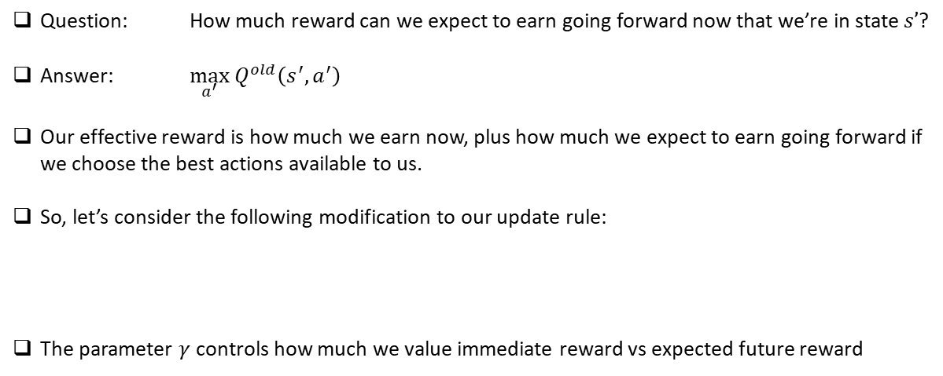
Let’s augment our reward to consider what happens next
$Q^{new}\left(s,a\right)←(1−α)⋅Q^{old}\left(s,a\right)+α⋅ r\left(s,a,s^{′}\right),$ with $α∈(0,1]$
Question: How much reward can we expect to earn going forward now that we’re in state $s’$?
Answer: $\max_{a^{′}} Q^{old}\left(s^{′},a^{′}\right)$
Our effective reward is how much we earn now, plus how much we expect to earn going forward if we choose the best actions available to us.
So, let’s consider the following modification to our update rule:
The parameter $γ$ controls how much we value immediate reward vs expected future reward
$Q^{new}\left(s,a\right)←\left(1−α\right)⋅Q^{old}\left(s,a\right)+α⋅[r\left(s,a,s^{′}\right)+γ⋅\max_{a^{′}} Q^{old}\left(s^{′},a^{′}\right)]$

Slide 25
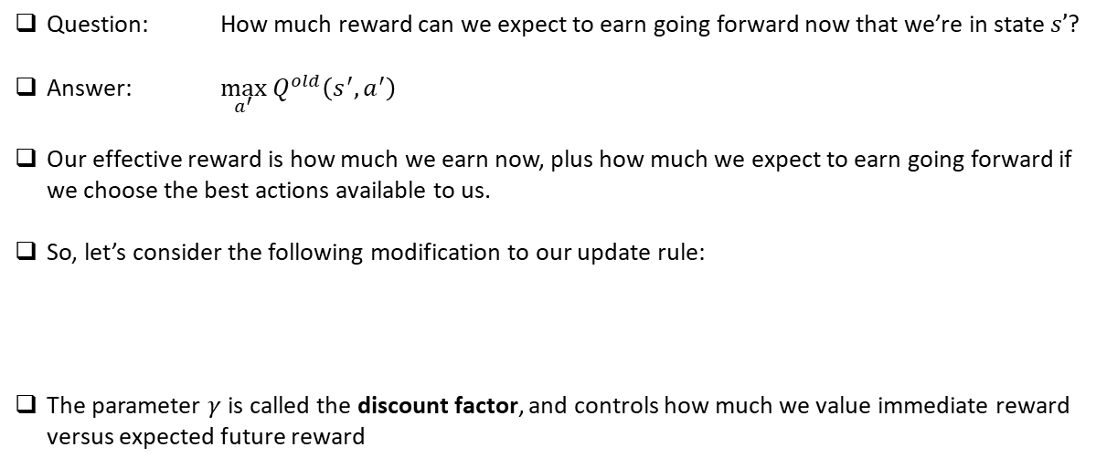
Let’s augment our reward to consider what happens next
$Q^{new}\left(s,a\right)←(1−α)⋅Q^{old}\left(s,a\right)+α⋅ r\left(s,a,s^{′}\right),$ with $α∈(0,1]$
Question: How much reward can we expect to earn going forward now that we’re in state $s’$?
Answer: $\max_{a^{′}} Q^{old}\left(s^{′},a^{′}\right)$
Our effective reward is how much we earn now, plus how much we expect to earn going forward if we choose the best actions available to us.
So, let’s consider the following modification to our update rule:
The parameter $γ$ is called the discount factor, and controls how much we value immediate reward versus expected future reward
$Q^{new}\left(s,a\right)←\left(1−α\right)⋅Q^{old}\left(s,a\right)+α⋅[r\left(s,a,s^{′}\right)+γ⋅\max_{a^{′}} Q^{old}\left(s^{′},a^{′}\right)]$

Slide 26

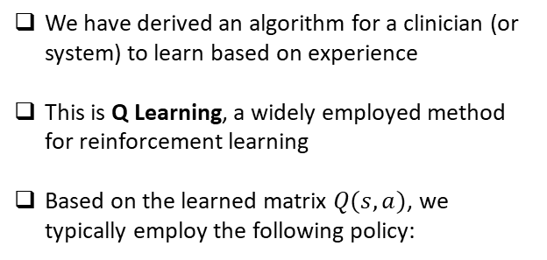
Non-Myopic Update Rule
Immediate
Reward
Discount Factor Between 0 and 1
$Q^{new}\left(s,a\right)←\left(1−α\right)⋅Q^{old}\left(s,a\right)+α⋅[r\left(s,a,s^{′}\right)+γ⋅\max_{a^{′}} Q^{old}\left(s^{′},a^{′}\right)]$
We have derived an algorithm for a clinician (or system) to learn based on experience
This is Q Learning, a widely employed method for reinforcement learning
Based on the learned matrix $Q(s,a)$, we typically employ the following policy:
Expected Future Rewards
Based on Optimal
Policy
$$π\left(s\right)=\underset{a}{argmax}{Q(s,a)}$$

Slide 27
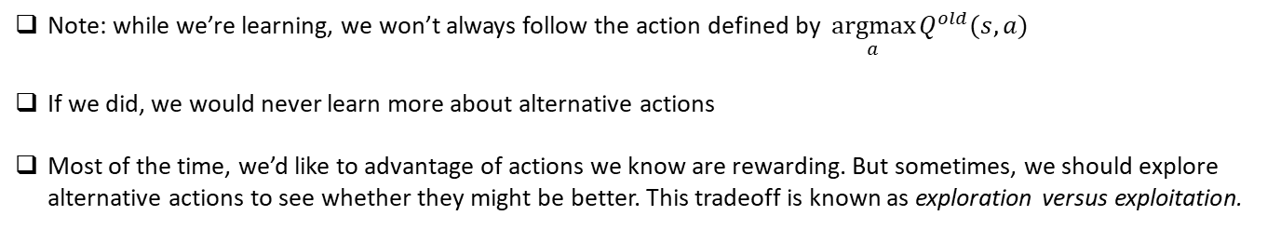
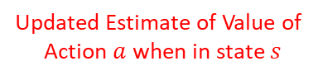
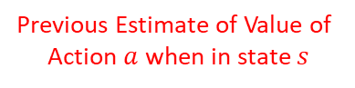
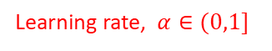
Q Learning
Learning rate, $α∈(0,1]$
Discount Factor Between 0 and 1
Immediate
Reward
$Q^{new}\left(s,a\right)←\left(1−α\right)⋅Q^{old}\left(s,a\right)+α⋅[r\left(s,a,s^{′}\right)+γ⋅\max_{a^{′}} Q^{old}\left(s^{′},a^{′}\right)]$
Updated Estimate of Value of
Action $a$ when in state $s$
Previous Estimate of Value of
Action $a$ when in state $s$
Expected Future Rewards
Based on Optimal
Policy
Note: while we’re learning, we won’t always follow the action defined by $\underset{a}{argmax}{Q^{old}(s,a)}$
If we did, we would never learn more about alternative actions
Most of the time, we’d like to advantage of actions we know are rewarding. But sometimes, we should explore alternative actions to see whether they might be better. This tradeoff is known as exploration versus exploitation.

Slide 28
Q Learning
Learning rate, $α∈(0,1]$
Discount Factor Between 0 and 1
Immediate
Reward
$Q^{new}\left(s,a\right)←\left(1−α\right)⋅Q^{old}\left(s,a\right)+α⋅[r\left(s,a,s^{′}\right)+γ⋅\max_{a^{′}} Q^{old}\left(s^{′},a^{′}\right)]$
Updated Estimate of Value of
Action $a$ when in state $s$
Previous Estimate of Value of
Action $a$ when in state $s$
Expected Future Rewards
Based on Optimal
Policy

Slide 29
GRIDWORLD
The canonical RL example…

Slide 30
Gridworld: States
¯\_(ツ)_/¯ T | _/\_
 |  |  |  |  |  | _______ // || \ \ _____//___||__\ \___ ) _ _ \ |_/ \________/ \___| ___\_/________\_/_____
The states are the different squares of gridworld.

Slide 31
Gridworld: Actions
 | UP
LEFT | ¯\_(ツ)_/¯ T | _/\_ | RIGHT
 | DOWN
The actions are:
Move left
Move right
Move up
Move down

Slide 32
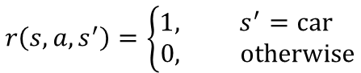
Gridworld: Rewards
_______ // || \ \ _____//___||__\ \___ ) _ _ \ |_/ \________/ \___| ___\_/________\_/_____
1 for reaching
0 otherwise
The goal is to reach the car. So our reward is:
$$r\left(s,a,s^{′}\right)=\left\{\begin{aligned}1, s^{′}=car \\ 0, otherwise\end{aligned}\right.$$
Notes:
Here emphasize that we have to look to FUTURE reward; better to get there faster
Alternatively, we can penalize each step

Slide 33
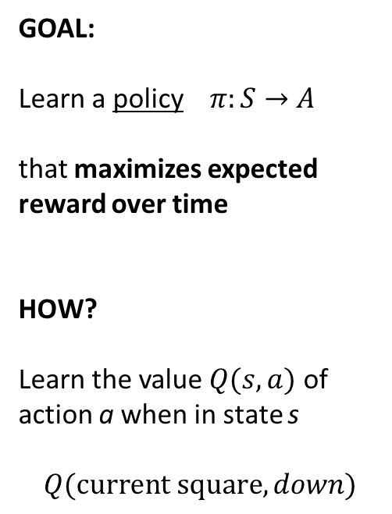
 |  |  |  | ¯\_(ツ)_/¯ T | _/\_
 |  |  |  |  |  | _______ // || \ \ _____//___||__\ \___ ) _ _ \ |_/ \________/ \___| ___\_/________\_/_____
GOAL:
Learn a policy $π:S→A$
that maximizes expected reward over time
HOW?
Learn the value $Q(s,a)$ of action a when in state s
$$Q(current square, down)$$
Notes:
Talk about the idea here. We initially don’t know the values of these actions; or could initialize with our best guesses.

Slide 34
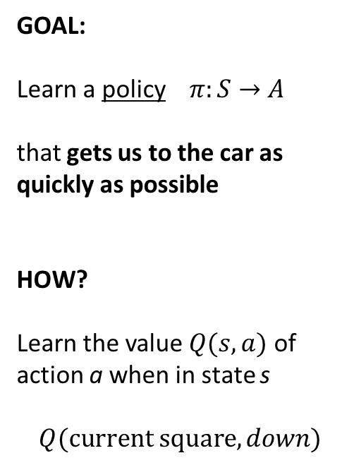
 |  |  |  | ¯\_(ツ)_/¯ T | _/\_
 |  |  |  |  |  | _______ // || \ \ _____//___||__\ \___ ) _ _ \ |_/ \________/ \___| ___\_/________\_/_____
GOAL:
Learn a policy $π:S→A$
that gets us to the car as quickly as possible
HOW?
Learn the value $Q(s,a)$ of action a when in state s
$$Q(current square, down)$$
Notes:
Talk about the idea here. We initially don’t know the values of these actions; or could initialize with our best guesses.

Slide 35
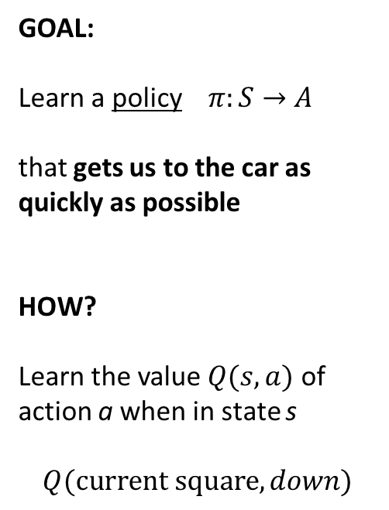
 |  |  |  |  |  | ¯\_(ツ)_/¯ T | _/\_
 |  |  |  |  |  | _______ // || \ \ _____//___||__\ \___ ) _ _ \ |_/ \________/ \___| ___\_/________\_/_____
GOAL:
Learn a policy $π:S→A$
that gets us to the car as quickly as possible
HOW?
Learn the value $Q(s,a)$ of action a when in state s
$$Q(current square, down)$$
Notes:
See an immediate reward associated with this action.

Slide 36
Gridworld Example
$$Q^{new}\left(s,a\right)←{\left(1−α\right)⋅Q}^{old}\left(s,a\right)+α⋅[ r\left(s,a,s^{′}\right)+γ⋅\max_{a^{′}} Q^{old}\left(s^{′},a^{′}\right) ]$$
¯\_(ツ)_/¯ T | _/\_
 |  | _______ // || \ \ _____//___||__\ \___ ) _ _ \ |_/ \________/ \___| ___\_/________\_/_____
Notes:
See an immediate reward associated with this action.

Slide 37
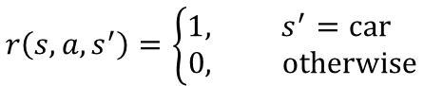
Gridworld Example
$$Q^{new}\left(s,a\right)←{\left(1−1\right)⋅Q}^{old}\left(s,a\right)+1⋅[ r\left(s,a,s^{′}\right)+.8⋅\max_{a^{′}} Q^{old}\left(s^{′},a^{′}\right) ]$$
$$r\left(s,a,s^{′}\right)=\left\{\begin{aligned}1, s^{′}=car \\ 0, otherwise\end{aligned}\right.$$
1 | 2 | 3
4\_(ツ)_/¯ T | _/\_ |  | 5
6 | 7 | _______ // || \ \ _____//___||__\ \___ ) _ _ \ |_/ \________/ \___| ___\_/________\_/_____
Notes:
See an immediate reward associated with this action.

Slide 38
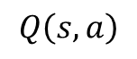
Gridworld Example
$$Q^{new}\left(s,a\right)←1⋅[ r\left(s,a,s^{′}\right)+.8⋅\max_{a^{′}} Q^{old}\left(s^{′},a^{′}\right) ]$$
$$r\left(s,a,s^{′}\right)=\left\{\begin{aligned}1, s^{′}=car \\ 0, otherwise\end{aligned}\right.$$
 | LEFT | RIGHT | UP | DOWN
Square 1
Square 2
Square 3
Square 4
Square 5
Square 6
Square 7
$$Q\left(s,a\right)$$
1 | 2 | 3
4\_(ツ)_/¯ T | _/\_ |  | 5
6 | 7 | _______ // || \ \ _____//___||__\ \___ ) _ _ \ |_/ \________/ \___| ___\_/________\_/_____
Notes:
See an immediate reward associated with this action.

Slide 39
Gridworld Example
$$Q^{new}\left(s,a\right)←1⋅[ r\left(s,a,s^{′}\right)+.8⋅\max_{a^{′}} Q^{old}\left(s^{′},a^{′}\right) ]$$
$$r\left(s,a,s^{′}\right)=\left\{\begin{aligned}1, s^{′}=car \\ 0, otherwise\end{aligned}\right.$$
ITERATION 0
 | LEFT | RIGHT | UP | DOWN
Square 1 | 0 | 0 | 0 | 0
Square 2 | 0 | 0 | 0 | 0
Square 3 | 0 | 0 | 0 | 0
Square 4 | 0 | 0 | 0 | 0
Square 5 | 0 | 0 | 0 | 0
Square 6 | 0 | 0 | 0 | 0
Square 7 | 0 | 0 | 0 | 0
$$Q\left(s,a\right)$$
1 | 2 | 3
4\_(ツ)_/¯ T | _/\_ |  | 5
6 | 7 | _______ // || \ \ _____//___||__\ \___ ) _ _ \ |_/ \________/ \___| ___\_/________\_/_____
Notes:
See an immediate reward associated with this action.

Slide 40
Gridworld Example
$$Q^{new}\left(s,a\right)←1⋅[ r\left(s,a,s^{′}\right)+.8⋅\max_{a^{′}} Q^{old}\left(s^{′},a^{′}\right) ]$$
$$r\left(s,a,s^{′}\right)=\left\{\begin{aligned}1, s^{′}=car \\ 0, otherwise\end{aligned}\right.$$
ITERATION 1
 | LEFT | RIGHT | UP | DOWN
Square 1 | 0 | 0 | 0 | 0
Square 2 | 0 | 0 | 0 | 0
Square 3 | 0 | 0 | 0 | 0
Square 4 | 0 | 0 | 0 | 0
Square 5 | 0 | 0 | 0 | 1
Square 6 | 0 | 0 | 0 | 0
Square 7 | 0 | 1 | 0 | 0
$$Q\left(s,a\right)$$
1 | 2 | 3
4\_(ツ)_/¯ T | _/\_ |  | 5
6 | 7 | _______ // || \ \ _____//___||__\ \___ ) _ _ \ |_/ \________/ \___| ___\_/________\_/_____
Notes:
See an immediate reward associated with this action.

Slide 41
Gridworld Example
$$Q^{new}\left(s,a\right)←1⋅[ r\left(s,a,s^{′}\right)+.8⋅\max_{a^{′}} Q^{old}\left(s^{′},a^{′}\right) ]$$
$$r\left(s,a,s^{′}\right)=\left\{\begin{aligned}1, s^{′}=car \\ 0, otherwise\end{aligned}\right.$$
ITERATION 2
 | LEFT | RIGHT | UP | DOWN
Square 1 | 0 | 0 | 0 | 0
Square 2 | 0 | 0 | 0 | 0
Square 3 | 0 | 0 | 0 | .8
Square 4 | 0 | 0 | 0 | 0
Square 5 | 0 | 0 | 0 | 1
Square 6 | 0 | .8 | 0 | 0
Square 7 | 0 | 1 | 0 | 0
$$Q\left(s,a\right)$$
1 | 2 | 3
4\_(ツ)_/¯ T | _/\_ |  | 5
6 | 7 | _______ // || \ \ _____//___||__\ \___ ) _ _ \ |_/ \________/ \___| ___\_/________\_/_____
Notes:
See an immediate reward associated with this action.

Slide 42
Gridworld Example
$$Q^{new}\left(s,a\right)←1⋅[ r\left(s,a,s^{′}\right)+.8⋅\max_{a^{′}} Q^{old}\left(s^{′},a^{′}\right) ]$$
$$r\left(s,a,s^{′}\right)=\left\{\begin{aligned}1, s^{′}=car \\ 0, otherwise\end{aligned}\right.$$
ITERATION 3
 | LEFT | RIGHT | UP | DOWN
Square 1 | 0 | 0 | 0 | 0
Square 2 | 0 | .8^2 | 0 | 0
Square 3 | 0 | 0 | 0 | .8
Square 4 | 0 | 0 | 0 | .8^2
Square 5 | 0 | 0 | .8^2 | 1
Square 6 | 0 | .8 | 0 | 0
Square 7 | .8^2 | 1 | 0 | 0
$$Q\left(s,a\right)$$
1 | 2 | 3
4\_(ツ)_/¯ T | _/\_ |  | 5
6 | 7 | _______ // || \ \ _____//___||__\ \___ ) _ _ \ |_/ \________/ \___| ___\_/________\_/_____
Notes:
See an immediate reward associated with this action.

Slide 43
Gridworld Example
$$Q^{new}\left(s,a\right)←1⋅[ r\left(s,a,s^{′}\right)+.8⋅\max_{a^{′}} Q^{old}\left(s^{′},a^{′}\right) ]$$
$$r\left(s,a,s^{′}\right)=\left\{\begin{aligned}1, s^{′}=car \\ 0, otherwise\end{aligned}\right.$$
ITERATION 4
 | LEFT | RIGHT | UP | DOWN
Square 1 | 0 | .8^3 | 0 | .8^3
Square 2 | 0 | .8^2 | 0 | 0
Square 3 | .8^3 | 0 | 0 | .8
Square 4 | 0 | 0 | 0 | .8^2
Square 5 | 0 | 0 | .8^2 | 1
Square 6 | 0 | .8 | .8^3 | 0
Square 7 | .8^2 | 1 | 0 | 0
$$Q\left(s,a\right)$$
1 | 2 | 3
4\_(ツ)_/¯ T | _/\_ |  | 5
6 | 7 | _______ // || \ \ _____//___||__\ \___ ) _ _ \ |_/ \________/ \___| ___\_/________\_/_____
Notes:
See an immediate reward associated with this action.

Slide 44
Gridworld Example
$$Q^{new}\left(s,a\right)←1⋅[ r\left(s,a,s^{′}\right)+.8⋅\max_{a^{′}} Q^{old}\left(s^{′},a^{′}\right) ]$$
$$r\left(s,a,s^{′}\right)=\left\{\begin{aligned}1, s^{′}=car \\ 0, otherwise\end{aligned}\right.$$
ITERATION 5
 | LEFT | RIGHT | UP | DOWN
Square 1 | 0 | .8^3 | 0 | .8^3
Square 2 | .8^4 | .8^2 | 0 | 0
Square 3 | .8^3 | 0 | 0 | .8
Square 4 | 0 | 0 | .8^4 | .8^2
Square 5 | 0 | 0 | .8^2 | 1
Square 6 | 0 | .8 | .8^3 | 0
Square 7 | .8^2 | 1 | 0 | 0
$$Q\left(s,a\right)$$
1 | 2 | 3
4\_(ツ)_/¯ T | _/\_ |  | 5
6 | 7 | _______ // || \ \ _____//___||__\ \___ ) _ _ \ |_/ \________/ \___| ___\_/________\_/_____
Notes:
See an immediate reward associated with this action.

Slide 45
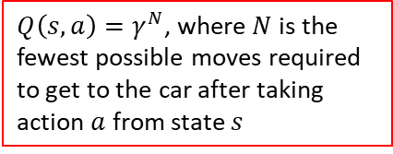
Gridworld Example
$$Q^{new}\left(s,a\right)←1⋅[ r\left(s,a,s^{′}\right)+.8⋅\max_{a^{′}} Q^{old}\left(s^{′},a^{′}\right) ]$$
$$r\left(s,a,s^{′}\right)=\left\{\begin{aligned}1, s^{′}=car \\ 0, otherwise\end{aligned}\right.$$
$Q\left(s,a\right)=γ^{N}$, where $N$ is the fewest possible moves required to get to the car after taking action $a$ from state $s$
 | LEFT | RIGHT | UP | DOWN
Square 1 | 0 | .8^3 | 0 | .8^3
Square 2 | .8^4 | .8^2 | 0 | 0
Square 3 | .8^3 | 0 | 0 | .8
Square 4 | 0 | 0 | .8^4 | .8^2
Square 5 | 0 | 0 | .8^2 | 1
Square 6 | 0 | .8 | .8^3 | 0
Square 7 | .8^2 | 1 | 0 | 0
$$Q\left(s,a\right)$$
1 | 2 | 3
4\_(ツ)_/¯ T | _/\_ |  | 5
6 | 7 | _______ // || \ \ _____//___||__\ \___ ) _ _ \ |_/ \________/ \___| ___\_/________\_/_____
Notes:
Again, gamma is the DISCOUNT FACTOR: trade-off between reward now versus later
- We didn’t need a learning rate here, because we didn’t have to worry about randomness

Slide 46
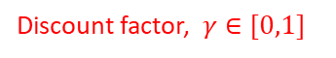
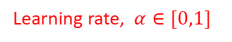
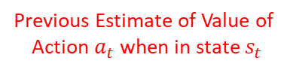
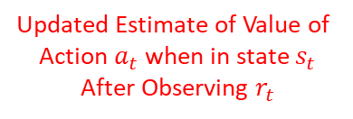
Q-Learning: Represent Q Function as a Look-Up Table
Learning rate, $α∈[0,1]$
Discount factor, $γ∈[0,1]$
$$Q^{new}\left(s_{t},a_{t}\right)←\left(1−α\right)⋅Q^{old}\left(s_{t},a_{t}\right)+α⋅[r_{t}+γ⋅\max_{a}{Q^{old}(s_{t+1},a)]}$$
Previous Estimate of Value of
Action $a_{t}$ when in state $s_{t}$
Updated Estimate of Value of
Action $a_{t}$ when in state $s_{t}$
After Observing $r_{t}$
Notes:
- As in other examples, this one was very simple – easy to see what action is right. But reinforcement learning allows us to act in environments where we don’t have this intuitive understanding.

Slide 47
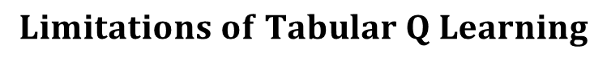
$$Limitations of Tabular Q Learning$$
$$Q^{new}\left(s_{t},a_{t}\right)←\left(1−α\right)⋅Q^{old}\left(s_{t},a_{t}\right)+α⋅[r_{t}+γ⋅\max_{a}{Q^{old}(s_{t+1},a)]}$$
Simple update rule, but …..
The Q function is stored as a table/matrix, which is impractical when considering
a large number of states and actions
No real capacity to generalize across sequence types, because the tabular Q function
does not have a functional form
Notes:
What if we don’t want to discretize the state?
Or we think this won’t be very effective

Slide 48

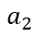
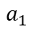
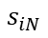
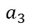
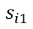
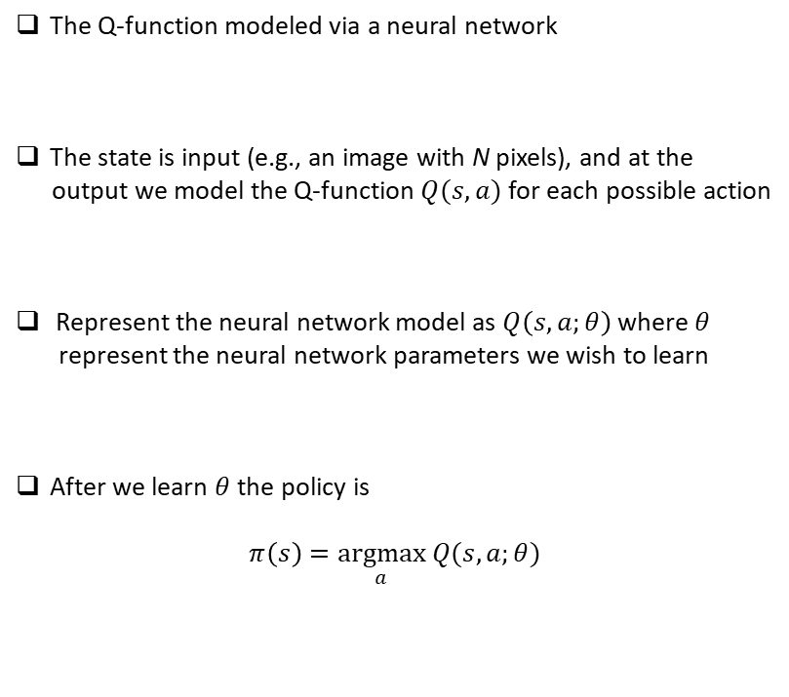
Deep Q Learning: Represent Q Function as a Deep Neural Network
$$a_{1}$$
$$a_{2}$$
$$a_{3}$$
The Q-function modeled via a neural network
The state is input (e.g., an image with N pixels), and at the
output we model the Q-function $Q(s,a)$ for each possible action
Represent the neural network model as $Q\left(s,a;θ\right)$ where $θ$
represent the neural network parameters we wish to learn
After we learn $θ$ the policy is
$$π\left(s\right)=\underset{a}{argmax} Q(s,a;θ)$$
$$s_{i1}$$
$$s_{iN}$$
Notes:
Network now tells us the value associated with each action when in a given state

Slide 49



$$Power of Deep Q Networks for RL With Images$$
Seek parameters $θ$ that best approximate the Q function
Predictive model for value
of state-action pair $(s_{t−1},a_{t−1})$

Slide 50

$$Power of Deep Q Networks for RL With Images$$
State $s_{t}$ (an image)

Slide 51

$$Power of Deep Q Networks for RL With Images$$
$$Q\left(s_{t},a_{t};θ\right)$$
for each $a_{t}∈A$
State $s_{t}$ (an image)

Slide 52


$$Atari Games$$

Slide 53


$$Final Thoughts$$
Tabular Q Learning employs the update rule
Deep Q Learning uses a deep neural network with parameters $θ$ to approximate the $Q$ function
Reinforcement learning has been studied for decades, and there are many other methods that we have
not considered here, and are worth learning about for those interested
There is also a rich theoretical foundation to RL, and therefore much is known about the fundamentals of
these methods
$$Q^{new}\left(s_{t},a_{t}\right)←\left(1−α\right)⋅Q^{old}\left(s_{t},a_{t}\right)+α⋅[r_{t}+γ⋅Q^{old}\left(s_{t+1},a_{t+1}\right)]$$

